Slide 1
AWS GEN AI

Slide 2
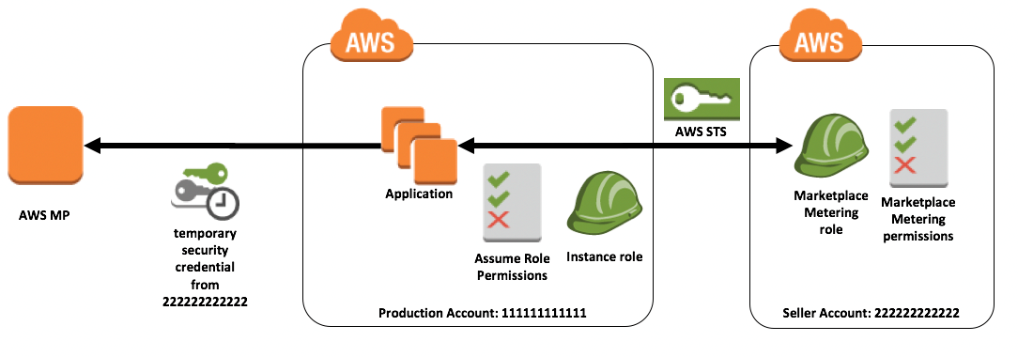
MODEL ACCESS & AWS MARKETPLACE

Slide 3
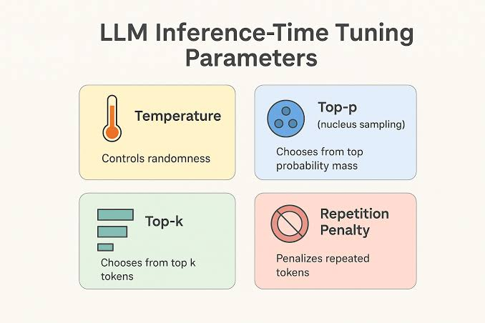
INFERENCE PARAMETERS

Slide 4
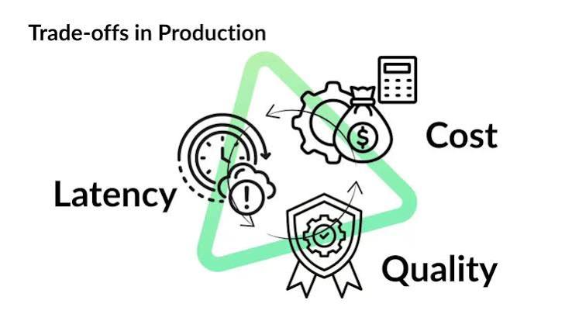
OPTIMIZING INFERENCE

Slide 5
THANKS FOR WATCHING

